Slide 1
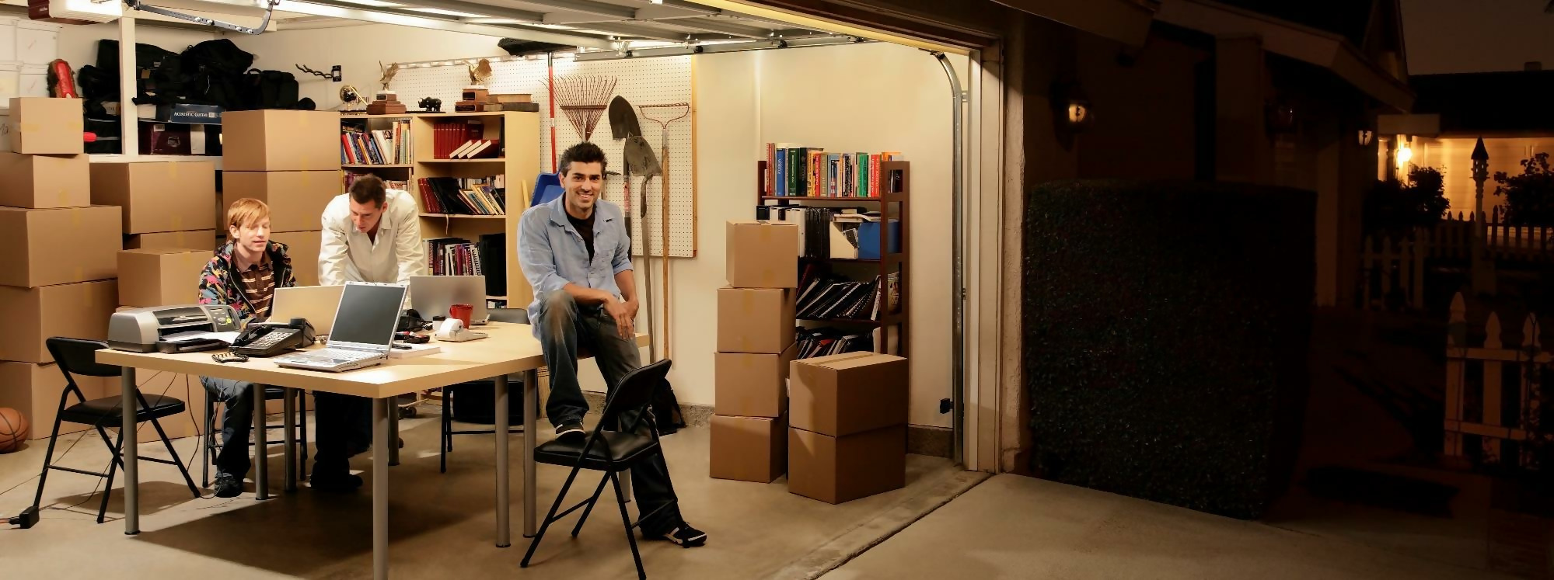

Python Final Project
Gulfairus Aliyar, Izel Abuova
Group: SE-2010
Instructor: Magzhan Ikram

Slide 2

Agenda
Introduction
Responsibilities
Project
Conclusion

Slide 3
Introduction
This is our final Python project. The project's purpose was to create a structured, functional bitcoin website with a summary and authorisation page. We used all of the essential libraries to design and implement this project. To begin, we've constructed a login page that, if the login and password match the data in our database, will transfer the user to the coin page; otherwise, it will indicate that the login is incorrect. The user must type the name of the cryptocurrency into the coin page, and it will display the data along with a summary.

Slide 4

Responsibilities Gulfairus: implemented by Izel: designed the web pages and built the permission system.

Slide 5
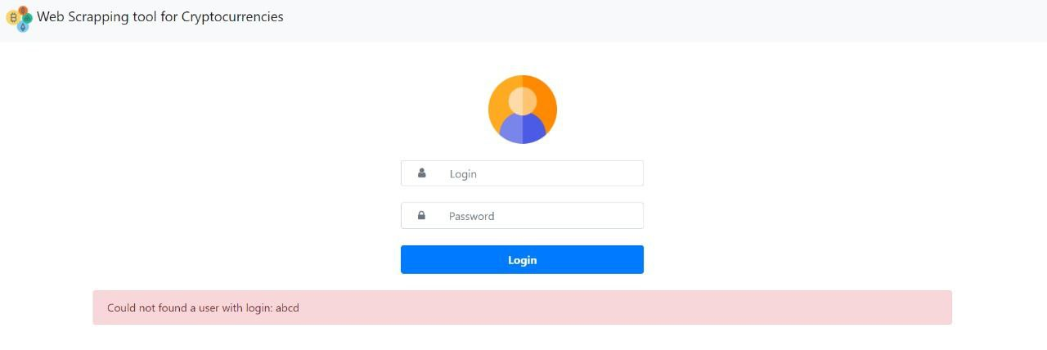
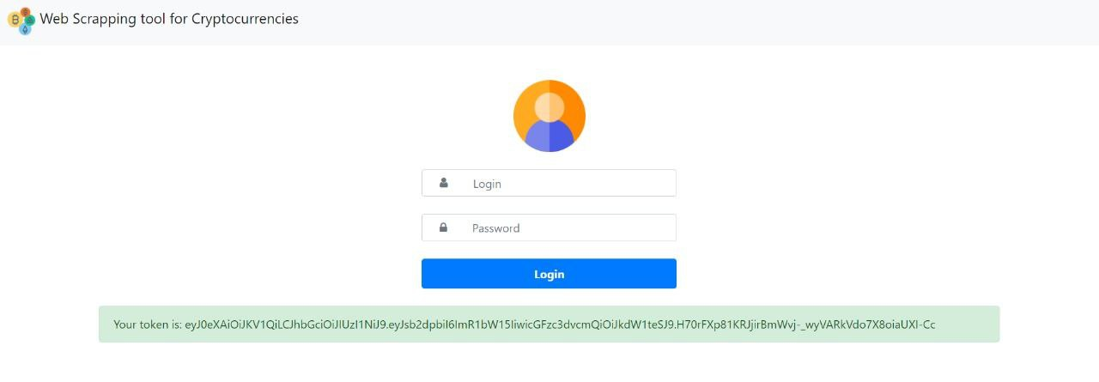
Our Project

Slide 6
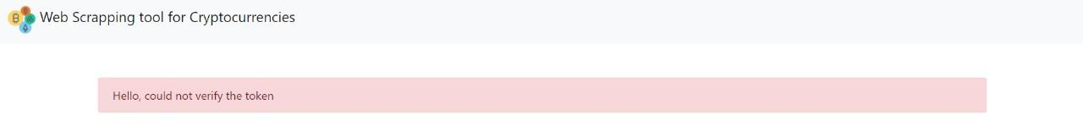
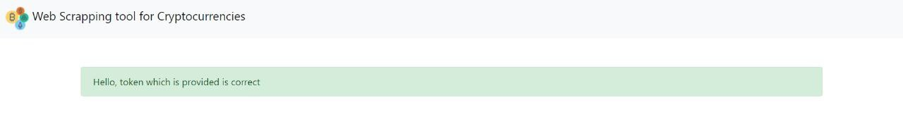

Slide 7
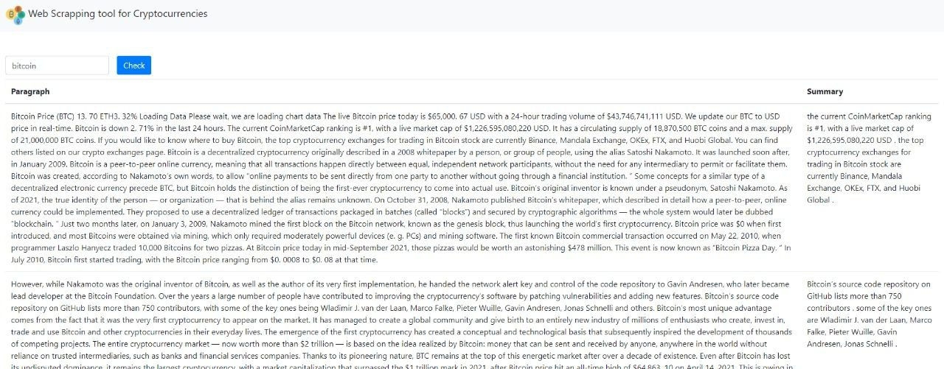

Slide 8
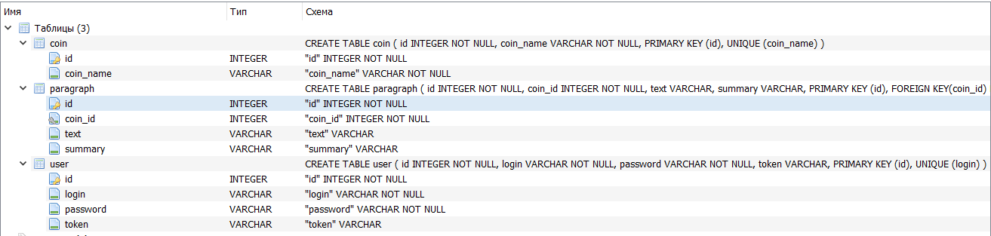
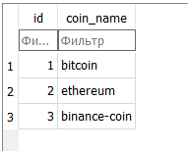
DB

Slide 9
Conclusion
As a result, our project failed. During the project, we had some problems connecting to the database, but unfortunately we could not solve this problem. This project was very interesting and we gained a lot of experience if we could not solve the mistake.

Slide 10
Thank you

